Slide 2
Presentation Outline
WiFiMon: Problem Statement, Architecture, Data Flow
Web-based Measurements
Hybrid Approach (Crowdsourced & HW Probe Measurements)
Security and Privacy Concerns
TNC19 Pilot & Results
Conclusions and Future Work
Notes:
Mobile Crowd Sensing System: An example and how Wifimon could proceed
WCsPM: Discuss several points to understand WiFiMon functionality (i) Concept Overview, (ii) Process, (iii) Architecture Building blocks, (iv) walk through (Data Flow Diagram), (v) GUI screenshots
Mobile application measurement: (i) Architecture, (ii) Mobile Measurements process
Hybrid Approach: (i) Prerequisites, (ii) Setup procedure
WiFiMon Security & Privacy: Beyond WCsPMV – eduroam SP and IdP policy/Process/
Results discussions End-User Meeting in Zurich (May 2017)

Slide 3
WiFiMon: Introduction
Mission Statement:
“…It is possible to gather data from multiple sources, including browser-based measurements, in addition to traditional monitoring, and extract meaningful information on the performance of a WiFi network from that data…”
Notes:
Generic statement:
Gather data from multiple sources,
Browser based measurement in addition to traditional monitoring
Extract Data: Accurate enough so that we can propagate a “Performance statement for a WiFi campus”
So we figured out a problem statement…

Slide 4
WiFiMon - Problem statement
Measuring and verifying the performance of WiFi networks is challenging.
There are no tools that:
Cover all aspects of performance monitoring and verification.
Determine how end-users experience WiFi at a given place on the network,
at a given time.
At present, information for wireless networks can be reported in three ways:
Mobile End-User Device
Wireless Access Points (WAP) / WiFi-Controller
Network Management Systems (NMS)
These sources allow “only” determining the wireless network is overall OK,
e.g. up/down
HW probes collect performance measurements but are installed at fixed locations. Crowdsourced measurements are also required.

Slide 5
WiFiMon Process
COLLECT DATA
STORE DATA
ANALYSE DATA
CONSUME and VISUALIZE of DATA
WiFi Interface
Focus: WiFi /eduroam enabled infrastructure
on Smart Devices
Temporary Data,
Persistent Data
- Raw data from data sources
- Persistent data (correlated)
Real Time Analysis:
Correlation: RADIUS Logs Accounting/Performance data
Mobility Prediction (future)
Focus: Network Performance
Focus: Crowd prediction etc.
Web-UI
- Visualization
- APIs
Multiple
Iteration Process
5
Notes:
The aim of our approach is to record network performance measurements by using collected raw data (data source) on WiFi and to visualize them. ==========
Temporary Data – Raw data from the data source
Persistent Data – Correlated data
==========
Only correlated data will be stored and analysed
Mobility prediction and focus is possible, so the correlation with the AP helps us to provide a localized statement to the network performance.
==========
The Web-User Interface is the Network Administrators view, about their own data. In our concept use Kibana (for visualization) and Elasticsearch (as a DB).
It is worth mentioning that previous WiFiMon versions used Grafana/InfluxDB and PostGresql

Slide 6
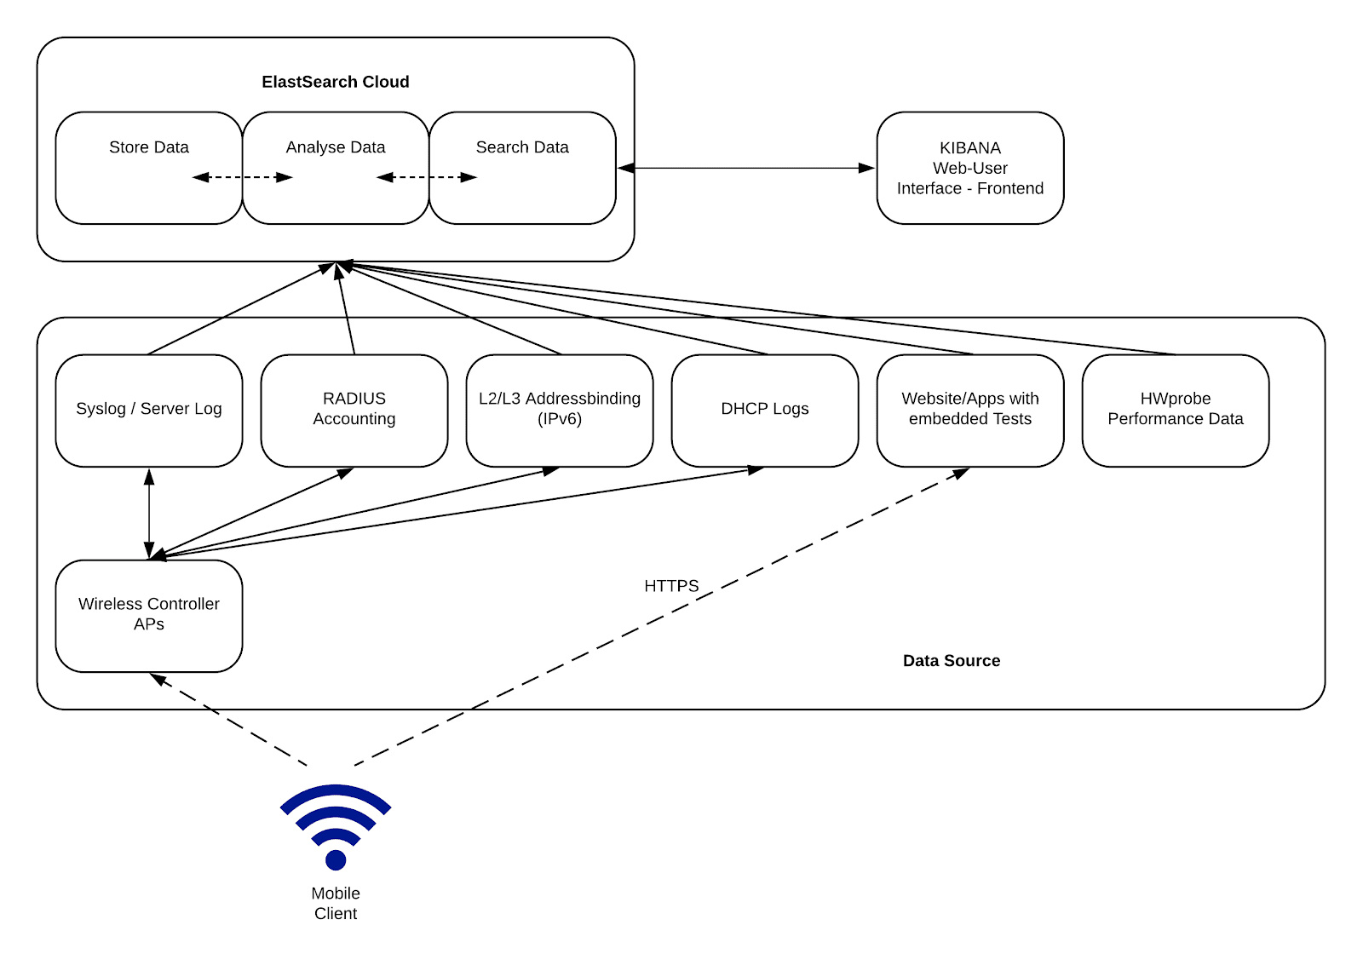
WiFiMon Architecture
Mobile Client
End-User device (tablet, mobile phone, etc.)
Data Source
Generates raw data and exports raw data from data source collectors
Elastic Cloud
Stores measurements (Elasticsearch)
Pipeline raw data to Elasticsearch (logstash, filebeat)
Web User Interface (Web-UI)
Allows real-time visualization options
Notes:
Mobile Client: In WiFiMon we have the mobile client connecting through eduroam to the WiFi network on the campus.
Data Sources: The data sources block includes:
(A) collected reference data generated by network performance tools (Boomerang, NetTest and HTML5) utilizing JavaScript code embedded on chosen web sources, running tests without client-intervention and performance data retrieved when the HW probes visit these web sources, and
(B) raw data from data sources (collectors) like Syslog, Server Log, RADIUS Accounting, DHCP logs that can help us identify the AP that the measurements were triggered from
Elastic Cloud: The raw data, will be automatically collected and feeded into the WiFiMon agent (Java based), where they are correlated and stored in the Elasticsearch database. Elasticsearch allows leveraging and accessing data at very high speeds and making it appropriate for WiFiMon. In addition, the Elastic cloud uses technologies such as “logstash” and filebeat to pipeline the raw data from the Data sources simultaneously, transform these data and send it to Elasticsearch. For scalability and security issues, the raw data from all APs will be sent to one database per site/campus.
Web-UI Interface: Raw and reference data from the Elastic Cloud accessible through a network admin Web-UI that allows querying and customized status checks of the wireless network. This block of the architecture is for projecting the collected data and allowing real-time visualisation options, such as: Collected data for a specific time period, collected data for a specific AP, min-max-mean values of download/upload/latency measurements, maps for measurements visualizations, Top/Bottom AP performance.

Slide 7
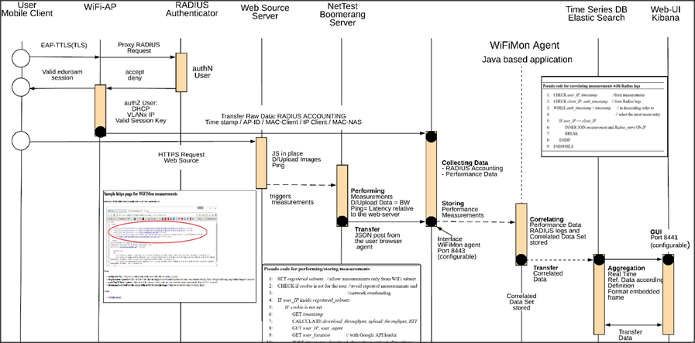
WiFiMon – Data Flow
Notes:
Mobile Client connects to the WAP with EduRoam.
The AP is proxying this request to the authentication identity (Radius Server)
After a successful authN, a Radius log entry (with time-stamp) takes place, and the an IP-address is assigned to the mobile client. The Radius log entry includes additional information such as Client MAC and IP address, AP MAC and IP, etc
The RADIUS accounting are streamed to the Elasticsearch database using technologies such as “logstash” and filebeat.
Once the Mobile Client visits a wifimon-enabled webpage (or wifimon app) performance tests (using open source approaches such as NetTest and Boomerang) are triggered automatically (using javascript). Once the measurements are completed, a JSON post is performed to send the results to the WiFiMon agent, where the performance tests are corellated with the Radius accounting data.
The Web-UI allows real-time visualisation options.
NetTest performance data, bandwidth (upload/download images)), and latency (RTTs (ping) will be correlation relevant for correlation – Time stamp / AP-ID / Mobile Client IP – only correlated data sets will be stored.

Slide 8
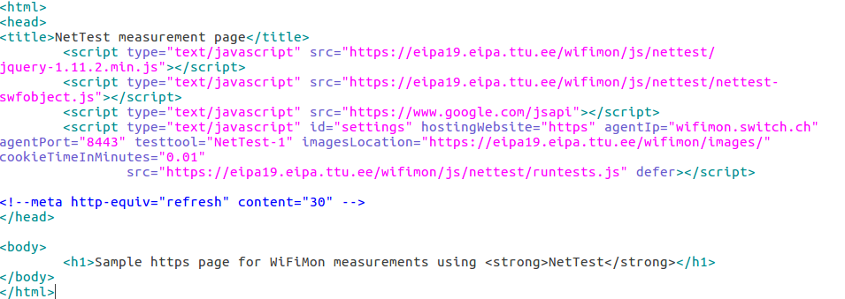
WiFiMon – eduroam enabled WiFi Infrastructure: Walk Through
The end user is required to visit a web page with JavaScript installed
User Information
Notes:
To the 1st step. -- web-server JS:
The Domain Name (e.g. www.switch.ch) or the IP of the web-server is needed
The location path of the images is important (location where the NetTest servers is running – Grnet)
Cookie time is essential, as we don’t like to affect the network --- non-invasive
Additional information:
The JS lines should be embedded at a frequently-visited web page (conference program, university website, etc)
The web page can be hosted anywhere without affecting the results
The agent could be installed anywhere, however it is advised to be installed near the conference venue or the university campus. The agent performs the correlations and stores the correlated measurements.
The measurement results are relative to the location of the web server, where the images are hosted.
The website, the WiFiMon agent and the test tool servers can be located at a different physical infrastructure. Only the test tool servers location affect the measurement results!!

Slide 9
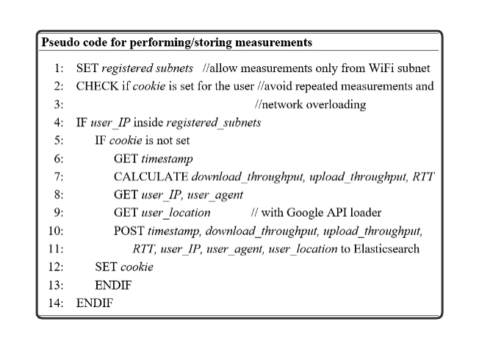
WiFiMon - Performing / Storing measurements
Network Overloading Avoidance:
Measurements accepted only from registered subnets
Cookie: repeated measurements in short time intervals are not permitted
Notes:
To the 2nd step - performing and storing of measurements at the database:
Per configuration:
Sub-Net defined => Measurements only from the sub-nets
Check is Cookie set, YES/NO => Expiration time after the measurements done – 1.5’

Slide 10
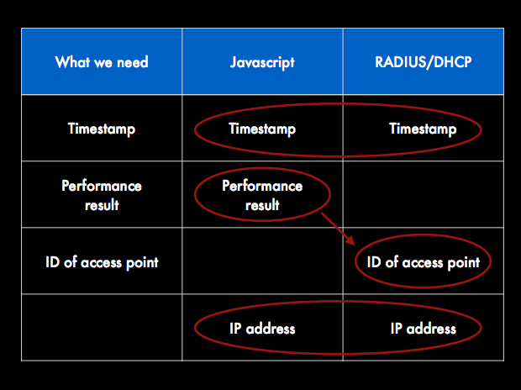
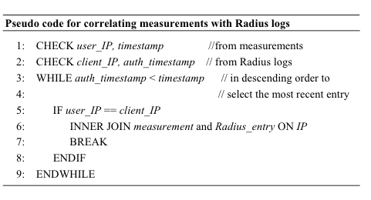
WiFiMon - How we manage/correlate performance data
Notes:
To the 3rd step:
Correlation Performance Data with RADIUS accounting:
Element:
User IP from measurements (javascript)
Client IP from authN/Z

Slide 11
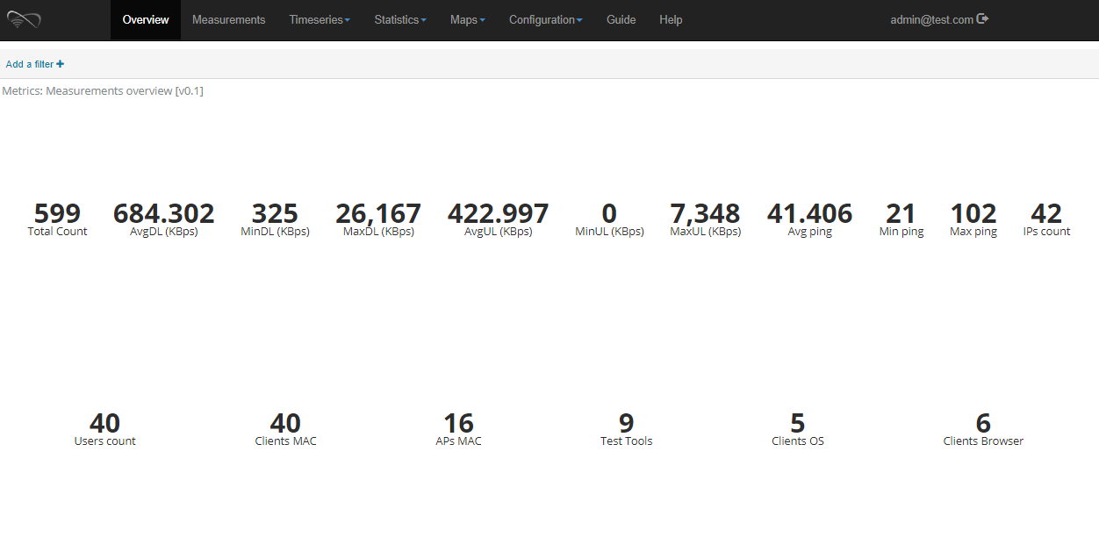
WiFiMon - Web-UI (Overview Tab)

Slide 12
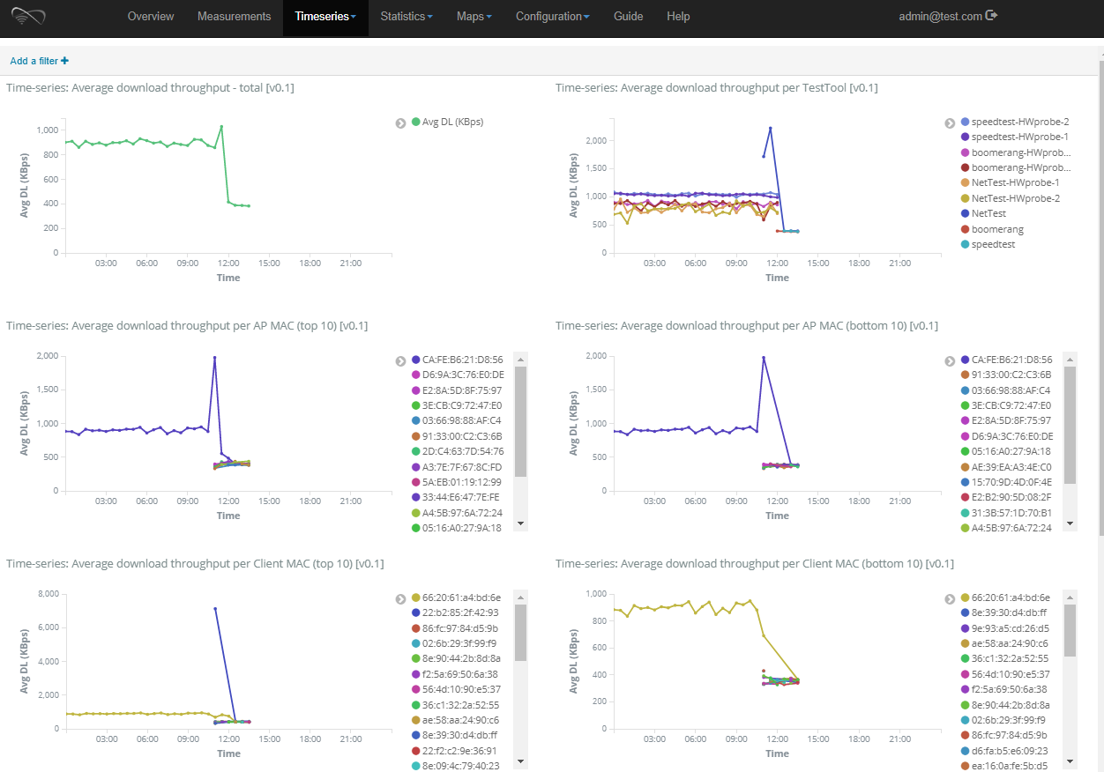
WiFiMon - Web-UI (Timeseries Tab)

Slide 13
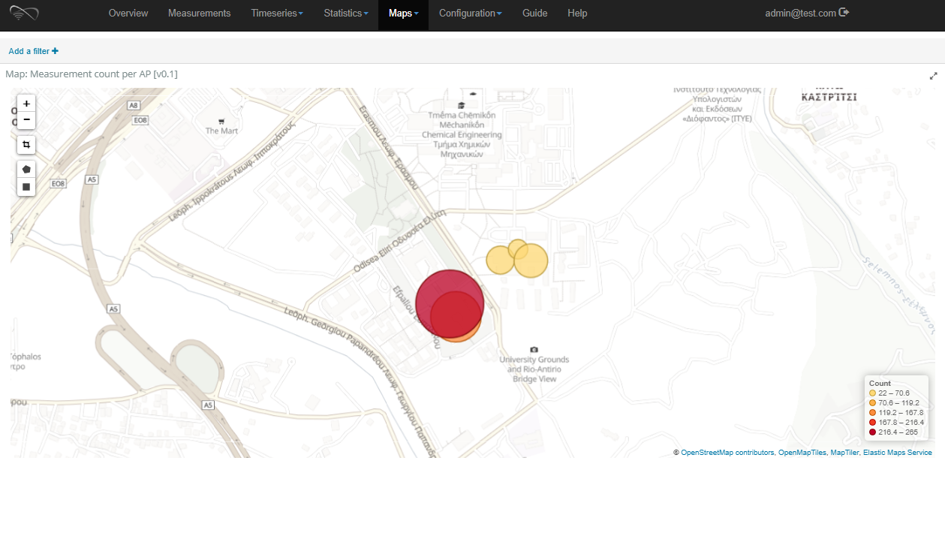
WiFiMon - Web-UI (Maps Tab)

Slide 14
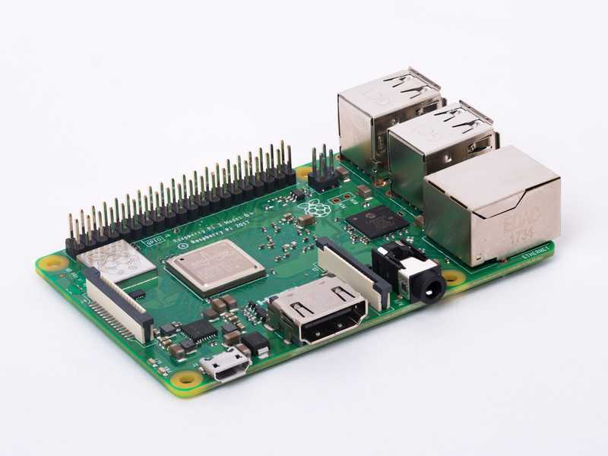
WiFiMon – Hybrid Approach
Prerequisites
A Raspberry Pi 3 Model B+
A micro SD card with at least 16GB size
WiFiMon Raspberry Pi operating system image. Size ~ 3.6 GB

Slide 15
WiFiMon – HW Probe setup steps
Step 1: Write the image to the micro SD card
Follow the instructions at the official Raspberry Pi. Skip the "Download the image" step and use the WiFiMon Raspberry Pi operating system image instead.
Step 2: Start the RPi
Insert the microSD in the RPi
Plug the USB keyboard and USB mouse
Connect the monitor cable to the Pi's HDMI port
Plug the power supply into a socket and connect it to the micro USB power port
The Pi will boot up into a graphical desktop
Step 3: Configure the RPi
Connect to the wireless network you want to measure.
Set which tests will be executed and how often
That's all! Unplug keyboard, mouse and monitor and let the HW probe measure your network!
Instruction page:
https://wifimon.switch.ch/wifimon/hw-probe-setup.html

Slide 16
WiFiMon – Security and Privacy
Process Data Management
Legal aspect of Collecting, Storing, Analysing, Consuming and Visualizing of data
Exercising caution when processing personal data (Management at SWITCH)
EC point of view about Privacy and Security to WiFiMon ➔ Legitimation
EU General Data Protection Regulation (GDPR)
Technical aspects
From beyond WiFiMon to concrete implementation of features
Collection process:
End-User dialog through popups (agree / disagree measurement)
Storing: Only correlated information (raw data will not be stored)
Web site – proper disclosure on WiFiMon process / data kept
Possibility to store only non-user related data
Hash user-related data
Notes:
Mitigation (various approaches):
Different dashboards
Hash the username (anonymization)
Proper disclosure of WiFimon process/data kept
Consent to participate / Opt-out
Measures based on AP only

Slide 17
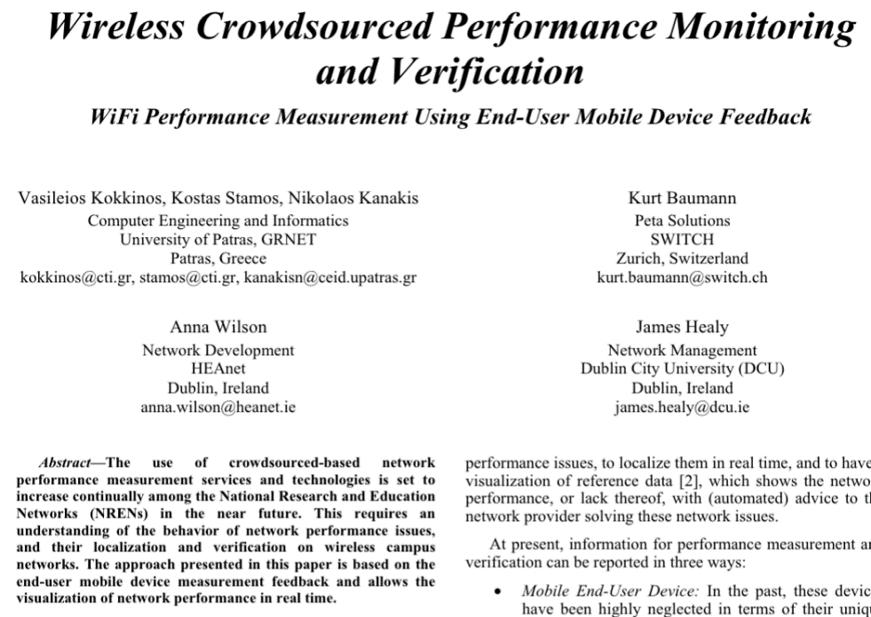

WiFiMon - Dissemination
TNC2015 – Porto
IEEE: ICT-2017, Limassol
May 2017
TNC2016 - Praha
IEEE: ICUMT- Lisbon
October 2016

Slide 18
WiFiMon Pilot @ TNC19

Slide 19
WiFiMon Milestones @ TNC19
Demonstration of WiFiMon capabilities in measuring the performance of WiFi networks
Comparison between crowdsourced measurements and deterministic measurements (HW Probes)
Deploying WiFiMon HW Probes in an event for the first time
Discussing with participants about potential enhancements and the future steps of WiFiMon

Slide 20
Available Equipment
5 Raspberry PI 3 Model B+, 64-bit quad-core ARMv8 CPU, 2.4 & 5 GHz, 802.11b/g/n/ac Wireless LAN, Bluetooth 4.2 & BLE
Laptops & Smartphones of WiFiMon team members
Why not TNC19 participants?
GDPR issues
WiFiMon was late to include its purposes in TNC19 privacy notice
Definitely in the future

Slide 21
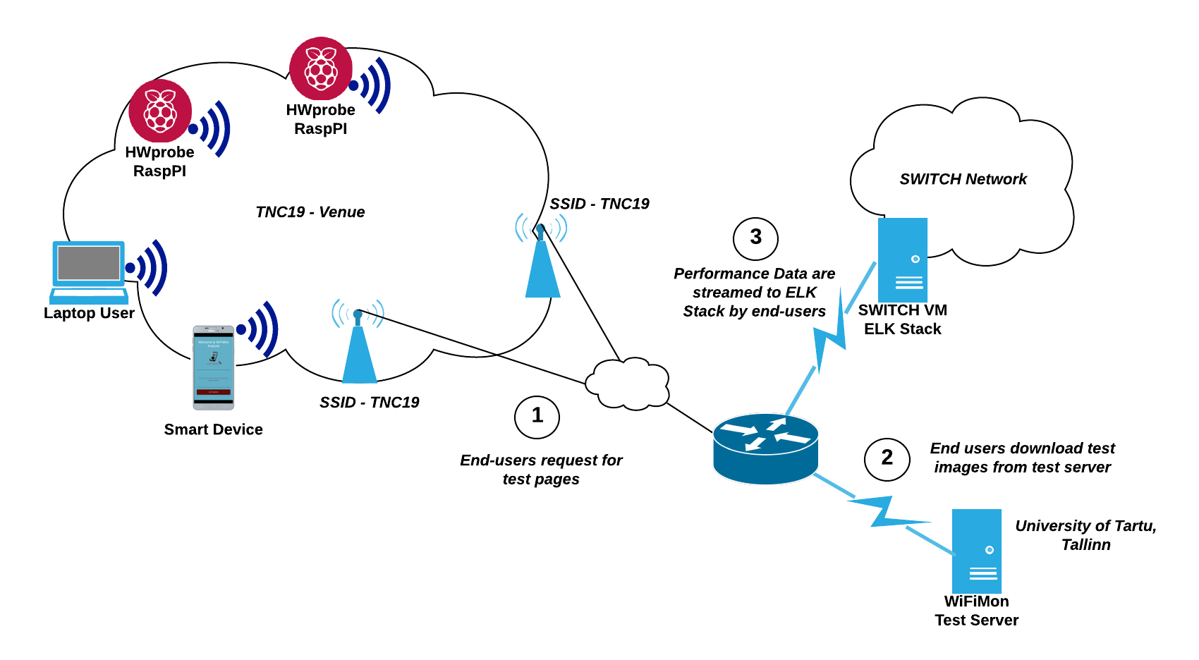
Testbed Overview

Slide 22
Available Test Tools
NetTest
Boomerang
Speedtest
10 available test pages per test tool (NetTest-x, boomerang-x, speedtest-x):
5 dedicated to each of the HW Probes (numbers 1, 5, 6, 7, 8)
5 assigned to WiFiMon team members (numbers 2, 3, 4, 9, 10)

Slide 23
Monitored Rooms
Small Hall & Small Hall Balcony (Posters)
Black Box room during the 1st round of lightning talks
Cauldron Hall
Atrium Hall
D- Hall

Slide 24
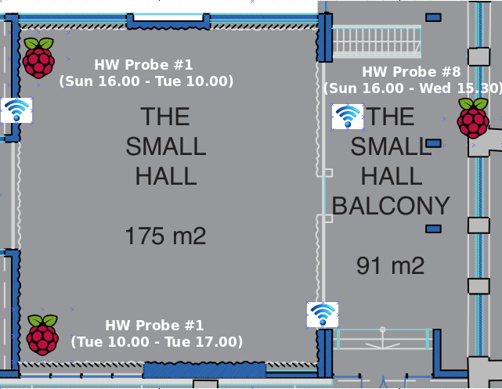
Small Hall & Small Hall Balcony (Posters)
HW Probe #1: Sunday 16.00 - Tuesday 10.00 (upper left corner)
HW Probe #1: Tuesday 10.00 - Tuesday 17.00 (lower left corner)
HW Probe #8: Sunday 16:00 - Wednesday 15.30 (poster area)

Slide 25
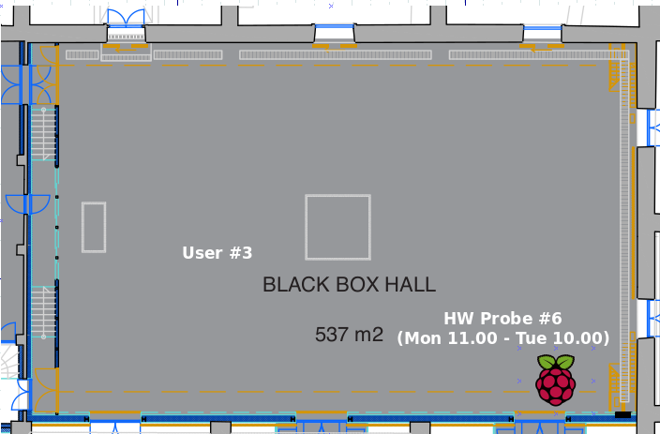
Black Box Room (Main Room & Lightning Talks)
HW Probe #6: Monday 11.00 - Tuesday 10.00
User #3: Monday 14.00 - Monday 15.30 (1st lightning talks round)

Slide 26
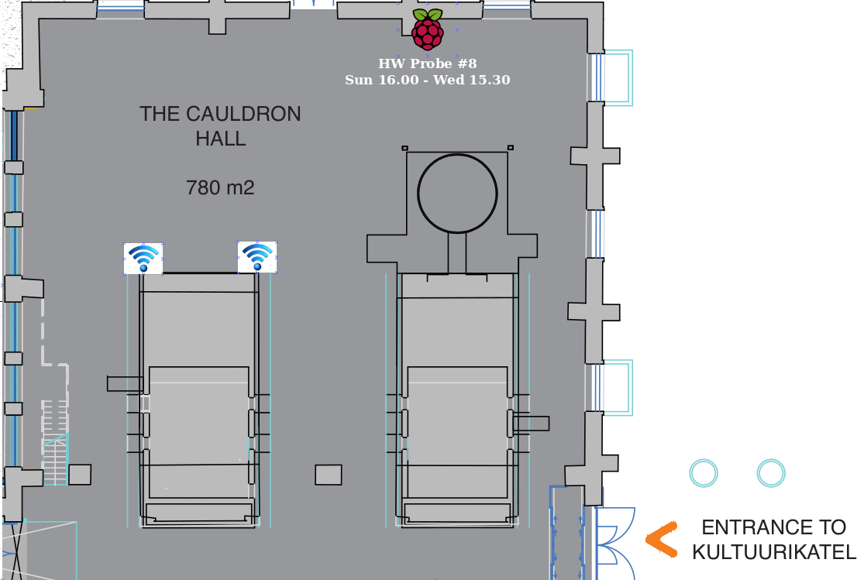
Cauldron Hall (Opening Plenary & Lobby)
HW Probe #8: Sunday 16.00 - Wednesday 15.30

Slide 27
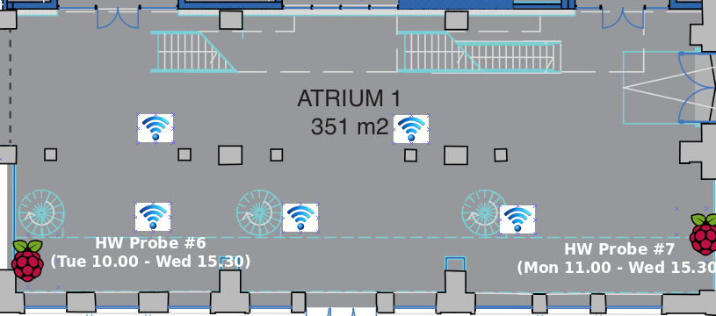
Atrium Hall (Coffee Breaks, Opening Reception)
HW Probe #6: Tuesday 10.00 - Wednesday 15.30
HW Probe #7: Monday 11.00 - Wednesday 15.30

Slide 28
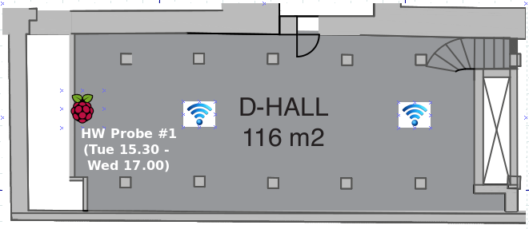
D-Hall (Some Sessions)
HW probe #1: moved to D-Hall in Tuesday 15.30

Slide 29
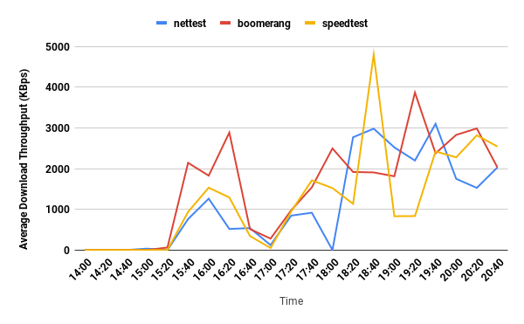
Download Throughput HW Probe #6 in Black Box,
Monday (14.00 - 21.00), including all test tools

Slide 30
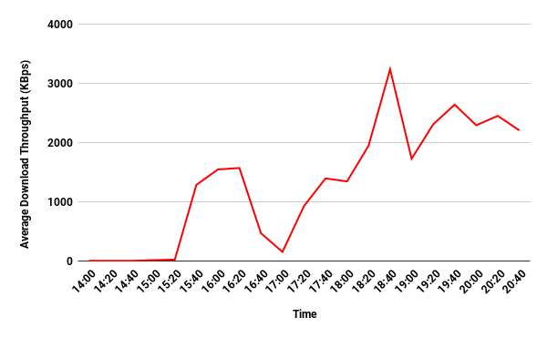
Download Throughput HW Probe #6 in Black Box,
Monday (14.00 - 21.00), Test tools average
WiFi problematic during lightning talks (14.00 - 15.20)
WiFi OK in the afternoon when lots of people have left the venue
Worse throughput during the opening reception (17.00)
WiFi OK in the evening

Slide 31
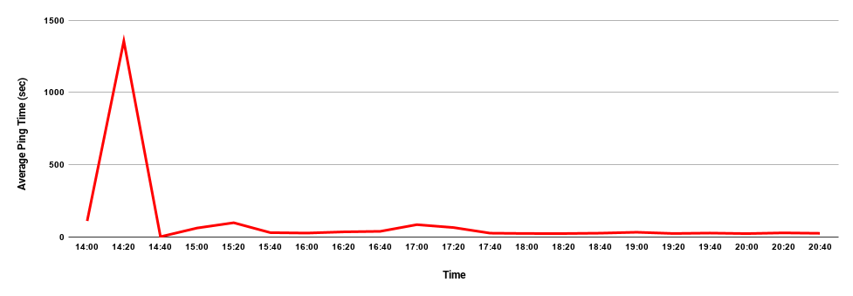
Average Ping Time, HW Probe #6 in Black Box,
Monday (14.00 - 21.00), Test tools average

Slide 32
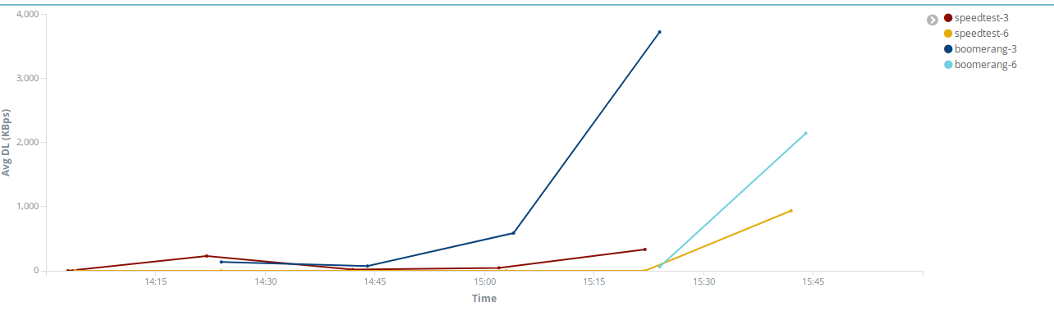
Comparison of crowdsourced measurements with HW Probe #6 during lightning talks on Monday (Download Throughput)
Both kinds of measurements follow the same trends

Slide 33
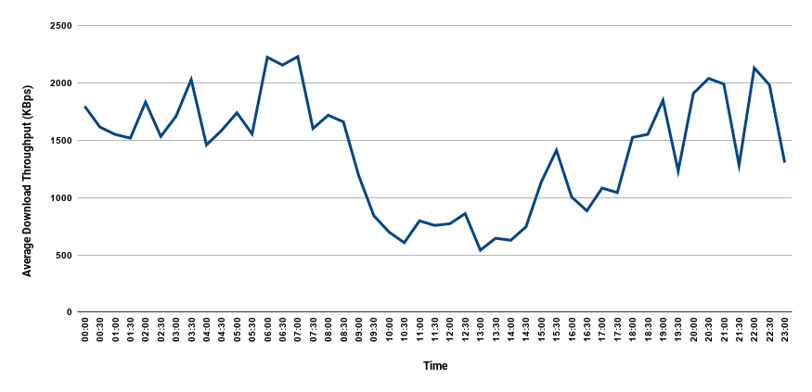
Download Throughput of HW Probe #1 in Small Hall, Monday (all day), Test Tools Average
Worse throughput when lots of people are in the venue

Slide 34
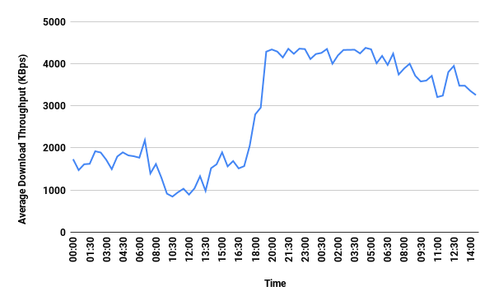
Download Throughput of HW Probe #1 moved from Small Hall to D-Hall, Test Tools Average
Worse throughput in Small Hall than in D-Hall

Slide 35
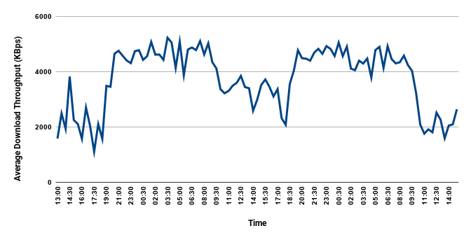
Download Throughput of HW Probe #7 in Atrium Hall, Monday 11.00 till Wednesday 15.30, Test Tools Average
Worse average download throughput during coffee breaks

Slide 36
Conclusions and future work
The expertise gained so far revealed that it is possible to:
Measure specific parameters of a wireless network through JavaScript
Correlate these measured raw data from various log files
Monitor and validate the performance of WiFi as experienced by end-users
Future steps:
Verification of JavaScript measurements accuracy (comparison with HW monitoring probes)
Explore privacy issues so as to be in accordance with campus policies
Inform the end-user through pop-ups, approve performance tests
Links or pop-ups that explain the process of data collection.
If tests are performed without user intervention, ensure that sensitive data will be analysed with caution.
Data Analysis (Elastic Search)
To process a long time history
To elaborate a “PERFORMANCE Benchmark”
Design a Service (roll out to the most of the NRENs)
Commercial aspect in focus of our investigations
Notes:
As a conclusion, we are able today:
To measure specific parameters, to correlate them
Make a quality statement through the end-user behavior
With Hybrid approach to validate our measurements
In the Future:
To force Data Analysis (Big Data Management)
With Data Analysis to understand better measured data
To design a service

